Slide 1
Comprehensive SDLC Playbook
Structured Query Language (SQL)
9-Jan-25

Slide 2
Table of Contents
Table of Contents
01
Scope and Focus of SQL Playbook
Defines the boundaries and areas of emphasis for the structured SQL playbook.
02
Key Considerations for Establishing a Robust Database System
Essential factors for building a scalable, efficient, and secure database system.
03
Software Development Lifecycle (SDLC)
An overview of the stages involved in SQL and database project development.
04
Essential Tools
Key tools for SQL development, testing, optimization, and database management.
05
Appendix
Additional resources and supporting materials for reference and further understanding.

Slide 3
Scope & Focus of the SQL Playbook

Slide 4




Scope of the playbook
Scope & Focus of the SQL Playbook
01
Target Audience
02
Transactional Databases
03
Analytical databases
04
Supported Systems
The target audience includes database administrators, developers, and IT professionals aiming to enhance their expertise in SQL-based relational database management systems (RDBMS).
Transactional databases are optimized for handling large number of transactions efficiently.
They maintain data integrity and support high-volume operations, making them vital for enterprise applications.
Analytical databases are designed to facilitate data analyses and reporting.
They allow users to extract insights from data through query optimization and data modeling techniques, enhancing business intelligence capabilities.
Supported systems include popular SQL-based RDBMS platforms such as Microsoft SQL Server, PostgreSQL, MySQL, and Oracle, highlighting their unique features and common use cases.
**Note : The scope of the SDLC process does not cover non-database related software components or purely frontend development.

Slide 5
Key Considerations for Establishing a Robust Database System

Slide 6





Key Considerations
Key Considerations for Establishing a Robust Database System
In today's data-driven world, robust database systems require aligning with business needs, reliable architecture, data integrity, performance optimization, and traceability to ensure seamless operations and informed decisions.
Alignment with Business Needs
Define and align database objectives with the business’s overarching goals to ensure strategic decision-making and operational effectiveness.
Reliable Database Architecture
Establish a database system that is not only robust but also scalable and efficient, ensuring it can grow and adapt alongside the business’s evolving needs.
Ensure Data Protection and Integrity
A critical aspect of our objectives is safeguarding sensitive data. Incorporate security measures seamlessly throughout the design and deployment phases.
Performance Optimizations
Prioritize efficiency and responsiveness throughout the entire lifecycle of the database project, ensuring optimal performance under varying workloads.
Traceability of Deliverables
Implement traceability for all deliverables through comprehensive tools such as Git, Azure DevOps or Jira, facilitating better project management and accountability.

Slide 7
Software Development Life Cycle (SDLC)

Slide 8





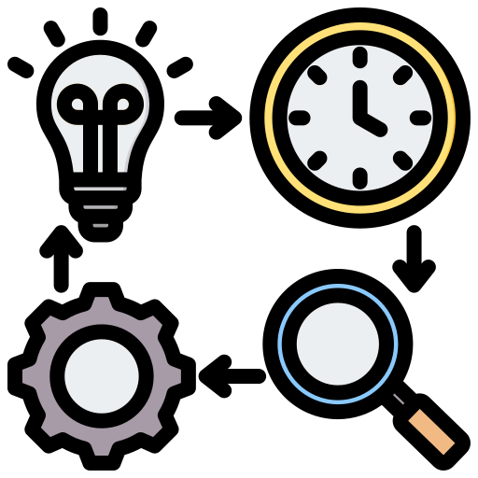


SDLC Phases
Software Development Life Cycle (SDLC)
The Software Development Life Cycle (SDLC) in the context of SQL refers to a systematic process for designing, developing, testing, and maintaining database systems and SQL-based solutions. It ensures efficient delivery of optimized, high-quality database structures, queries, and integrations that align with the application's data requirements and business objectives.
Develop tables, views, stored procedures, and other SQL components.
Design database schemas, relationships, and normalization structures.
Validate SQL queries, optimize performance, and ensure data integrity.
04
Development
05
03
Define the SQL roadmap, allocate resources, assess risks, and configure environments to ensure a structured development process.
Design
Testing
Deploy the database to the Production environment with necessary configurations.
02
06
Planning
Deployment
Identify data requirements, storage needs, and business rules for the database.
01
07
Monitor database performance, apply updates, and resolve issues.
Requirement
Maintenance

Slide 9
Phase 01 - Requirement Gathering / Analysis

Slide 10
SDLC Phases
Requirements Gathering
The purpose of the Requirements Gathering Phase is to understand and document the specific needs of the database project, ensuring alignment with business goals and technical objectives.
Entry Criteria :
Project charter and objectives are finalized
Stakeholder approvals are in place to proceed with detailed requirements gathering
Gather Data Requirements
Initiate the requirements phase by collecting comprehensive data needs from stakeholders
This involves understanding the existing data models and how they relate to organizations objectives
01
Key Technical Areas to Explore During the Requirements Phase
Database Architecture and Design
Data Access and Security
Data Quality & Maintenance
SQL Practice & Standards
Integration & Automation
Development and Testing Processes
Collaboration & Documentation
**Refer to the SQL Technical Questions document for potential questions related to these technical areas.
Exit Criteria :
Data Profiling Report
Compile findings from the data profiling process into a standard report (Data Profiling report template)
This document will highlight key insights regarding data quality and any discrepancies found during analysis
Define SQL Features
Identify and document necessary SQL functionalities essential for data handling
This includes specifying requirements for stored procedures, triggers and indexing strategies to optimize performance
02
SQL Requirement Document
Create a detailed SQL requirements document that encompasses all identified features and functionalities needed for data management
This document serves as a guide for development and implementation
Conduct Data Profiling
Perform thorough data profiling to evaluate the quality, integrity and volume of the available data
This step is crucial for identifying potential issues and ensuring that the data meets the required standards
03

Slide 11
Phase 02 - Planning

Slide 12
SDLC Phases
Planning
The Planning Phase ensures that all aspects of database development, resource allocation, and risk management are meticulously planned.
Entry Criteria :
Detailed database requirements (data entities, operations, performance metrics) are documented and validated.
Approval to proceed with database project planning.
Process
Development Roadmap & Resource planning
Environment Setup
Set Up a DevOps Board
Assign roles, identify tools, and schedule SQL training as needed.
Plan DDL and DML tasks with timelines for procedures, triggers, and optimizations.
Define dev, testing, UAT, and production environments.
Configure database parameters (e.g., memory, timeouts) and set up version control.
Use tools like Azure dev-Ops to track user stories (schema design, procedures, indexing).
Assign tasks, set dependencies, define timelines and acceptance criteria for validation.
Exit Criteria :
A detailed roadmap for SQL development, testing, and deployment is approved by stakeholders.
SQL environments are configured, and necessary access permissions are granted.
The DevOps board is populated with user stories, assigned to team members, and prioritized for execution.
Risks are documented along with mitigation plans.
All stakeholders sign off on the SQL-focused execution plan, enabling the Design Phase to begin.
02
04
01
03
05
Risk Assessment
Database Configuration
Identify risks like indexing issues, poor query design, and data migration challenges.
Plan mitigations: query reviews, iterative testing, and rollback strategies. Refer to the SQL Best Practices document.
Plan for collation, partitioning, backups, and disaster recovery readiness.
Coding
**Note : Click here to view the effort estimation for SQL development based on a sample mockup..

Slide 13
Phase 03 - Design

Slide 14

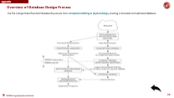
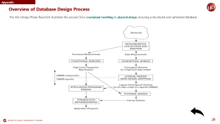
SDLC Phases
Design
The Design Phase translates the requirements gathered in the previous stage into a structured blueprint for the database. It ensures the system is logically sound, scalable, and optimized for performance while meeting the functional and technical needs.
Entry Criteria :
Completed planning, including resource allocation and environment setup.
Stakeholder approval for the direction of database design.
Logical Design
Conceptual Design
Definition : Transform the conceptual design into a detailed schema with tables, columns, keys, and constraints, ensuring data integrity and normalization.
Purpose : To offer a flexible framework for implementation across database platforms.
Deliverable : Normalized schema and relational diagrams.
Physical Design
Definition : Create a high-level database structure to capture entities, attributes, and relationships without implementation details.
Purpose : To Align the design with business needs and clarify for stakeholders.
Deliverable : ER diagrams depicting entities and their relationships.
Definition : Optimize the logical design by defining storage, indexing, partitions, and configurations.
Purpose : To ensure efficient performance and resource optimization.
Deliverable : Physical schema scripts, indexing strategies, and deployment configurations.
Exit Criteria :
ER diagram, normalized schema, and index strategy are finalized.
Backup, recovery, and security plans are documented and approved.
Design documents are signed off by stakeholders.
Flowchart for the Design Phase

Slide 15
Phase 04 - Development

Slide 16
SDLC Phases
Development
The purpose of the Development Phase is to build the actual database components and implement the design specifications into a working system. This stage focuses on creating, optimizing, and securing the database to meet functional, technical, and performance requirements.
01
Entry Criteria :
Database design (ER diagrams, schema) and security/recovery plans are finalized.
Project approval to begin development.
DATABASE CREATION
Develop the database schema, including tables, relationships, and constraints.
02
SCRIPT DEVELOPMENT
Write DDL, DML scripts, and create stored procedures, triggers, and views.
03
QUERY OPTIMIZATION
Ensure SQL queries are optimized for performance through indexing and tuning
Exit Criteria :
All required SQL scripts are written, tested, and stored in version control.
All database components (tables, stored procedures, triggers) are implemented and tested in the development environment.
04
SECURITY IMPLEMENTATION
Apply role-based access controls (RBAC), encryption, and other security measures to protect data.
**Note : Refer to the detailed SQL Best practices document.

Slide 17
Phase 05 – Testing

Slide 18



SDLC Phases
Testing
The primary objective of the testing phase is to validate the database’s functionality, performance and security. This ensures that the database operates as intended, meets user requirements and safeguards data integrity.
Unit Testing
Validate individual database components, such as stored procedures, triggers, and views.
Ensure that each script executes correctly and produces the expected results.
Test for compliance with defined constraints (e.g., primary/foreign keys, NOT NULL).
Entry Criteria :
Completed and Stored SQL Scripts in the Development Phase : Ensure all SQL scripts, including DDL, DML, and any custom procedures or triggers, are finalized, stored in a version control system, and ready for execution in the test environment.
Performance Testing
Load Testing: Simulate high user or transaction loads to measure database performance under heavy demand. Popular tools include SQL Server Distributed Replay, Apache JMeter, LoadRunner, and Benchmark Factory.
Query Optimization: Use tools like execution plans to identify and resolve slow-running queries.
Exit Criteria :
Ensure All Test Cases are Passed: Verify that all functional, integration, and performance tests are completed successfully with no unresolved critical issues.
Confirm Database Stability and Security: Check that the database operates reliably under expected loads and all security measures are validated.
Document Results and Resolve Issues: Record all test results and ensure any identified defects are fixed and re-tested before proceeding.
Backup and Recovery Testing
Validate full, incremental, and differential backups.
Simulate failure scenarios to ensure that data can be restored without loss or corruption.
**Note: Click here for more info on the Testing Tools

Slide 19
Phase 06 – Deployment

Slide 20
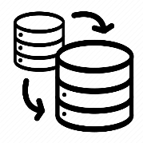



SDLC Phases
Deployment
The primary objective of deployment phase is to transition the finalized database to the production environment, ensuring seamless integration, data integrity, and optimal performance for end-users.
Entry Criteria :
Approval for Production Deployment: Ensure all stakeholders have reviewed and approved the deployment plan and final database structure.
Thorough Testing Completed: All functional, performance, and security tests are passed, with no unresolved critical issues.
Backup of Current Database: Take a full backup of the existing production database to ensure a rollback option in case of issues.
SQL Scripts Deployment
Deploy the database schema, objects (tables, views, stored procedures, etc.), and initial data to the Production environment.
Use CI/CD pipelines or migration tools to ensure consistent and error-free deployment.
End to End Validation
Test the database in combination with the application or systems it supports.
Ensure all SQL queries, scripts, and stored procedures perform correctly in real-world scenarios.
Unit testing
Exit Criteria :
Validation of Database Functionality: Confirm all queries, stored procedures, and triggers are functioning as expected in the production environment.
Performance Metrics Check: Ensure performance metrics such as query execution times and resource utilization meet predefined thresholds
Stakeholder Approval: Obtain confirmation from stakeholders that the deployment is successful and meets all project requirements.
Allow users or business stakeholders to interact with the system to verify that the database meets the functional requirements.
Validate reports, dashboards, or outputs generated from the database.
Feedbacks & Adjustments
Gather feedback from users and testers regarding functionality, usability, and performance.
Implement necessary changes and validate the adjustments in the UAT environment.

Slide 21
Phase 07 – Maintenance

Slide 22


SDLC Phases
Maintenance
The primary objective of maintenance phase is to ensure long-term performance, security, and scalability of the database system.
Entry Criteria :
Deployment Completion: The database is live in production and handed over to the maintenance team.
Monitoring Tools Setup: Ensure systems like SolarWinds, New Relic, or Azure Defender are configured and operational for tracking performance, errors, and security alerts.
Documentation Available: Deployment and operational documentation, including backups and configuration details, is finalized and shared.
Monitoring
Monitor Key Metrics: Track response times, throughput, and resource utilization to assess database performance.
Proactive Issue Resolution: Identify and address potential issues early to maintain optimal operation and user experience.
Backup & Recovery
Backup Strategy: Perform regular backups of critical data to safeguard against data loss.
Recovery Testing: Test recovery procedures and maintain a disaster recovery plan for quick and accurate data restoration.
Performance Tuning
Exit Criteria :
Backups Verified: Regular backups are conducted, tested, and stored securely, ensuring recoverability.
Issues Resolved: All reported issues are resolved promptly with no unresolved critical defects.
Stakeholder Satisfaction: Regular updates and resolved issues meet stakeholder expectations, ensuring business continuity.
Performance Analysis: Examine query execution plans to identify and resolve inefficiencies.
Optimization Strategies: Enhance speed and efficiency by implementing indexing and rewriting queries.
Change Management
Change Documentation: Record all database modifications and obtain necessary approvals.
Pre-Deployment Testing: Test changes thoroughly to ensure stability and minimize disruptions.
**Note: Click here for more info on the Monitoring Tools

Slide 23
Essential Tools for development & Testing

Slide 24







Essential Tools
Tools for Development & Testing
Modelling
Lucid Chart
Draw.io
These tools facilitate the visualizations of complex systems, workflows and processes
Database
SQL Server Management Studio (SSMS)
PgAdmin
SSMS and pgAdmin are essential tools for managing databases, with SSMS offering a rich interface for SQL Server and pgAdmin serving PostgreSQL
Monitoring
SQL Profiler
SQL Profiler allows for the tracking of SQL server events to diagnose performance issues

Slide 25
Appendix

Slide 26
Appendix
Appendix
This document contains technical questions related to SQL that can be asked during the requirements phase to assess key aspects of database design and functionality
This document contains best practices for SQL development, covering schema design, views, stored procedures, and performance monitoring with SQL Profiler and Extended Events, along with a comparison of these tools and a structured SQL training plan.
This attachment provides a concise step-by-step guide for identifying and resolving SQL Server performance issues. The guide includes detailed actions, tool usage, and query examples to analyze server metrics and implement effective optimizations
This document provides examples of ER diagrams for both star and snowflake schemas, along with detailed table schemas, to illustrate data modeling techniques and their applications in database design.
**Note : The queries and output provided are based on SSMS and may vary depending on the RDBMS.
The SQL Troubleshooting Cookbook is a focused guide that provides step-by-step methods to debug and resolve issues in SQL Server. It covers practical techniques for diagnosing query failures and helping users efficiently identify and fix SQL Server issues.
The SQL Database Creation Checklist is a template provided to clients to guide them in creating a SQL database in their environment. It includes specifications such as database size, buffer size, growth settings, and other relevant configuration parameters.
This Data Profiling Report Template is designed to help analyze and assess the quality of data in a database table. It captures essential data profiling metrics such as null value percentages, distinct values, data type consistency, and statistical summaries for numerical and categorical columns.
This document outlines the user acceptance criteria for the mockup components from a SQL perspective.

Slide 27
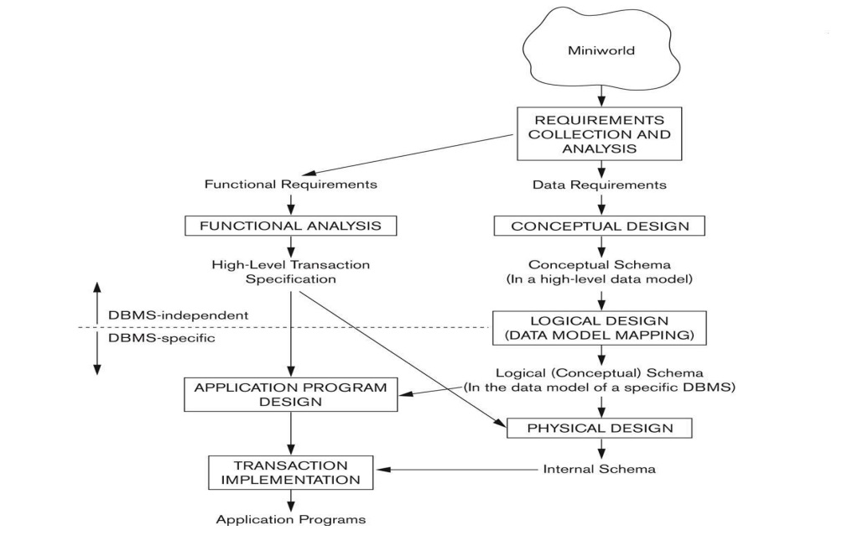

Appendix
SDLC Phases
Overview of Database Design Process
The SQL Design Phase flowchart illustrates the process from conceptual modeling to physical design, ensuring a structured and optimized database.

Slide 28
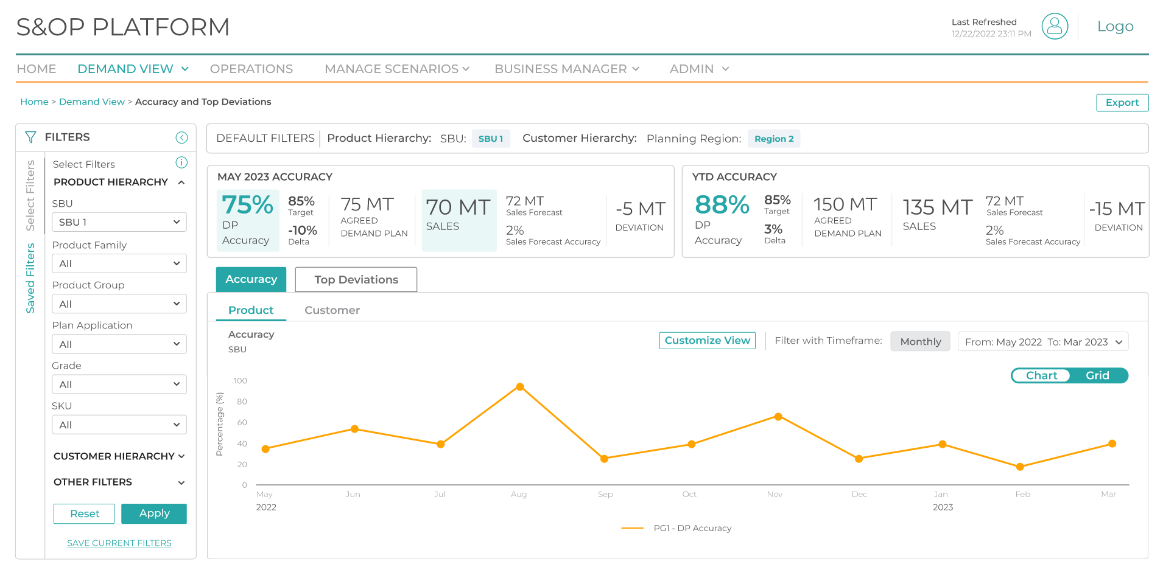
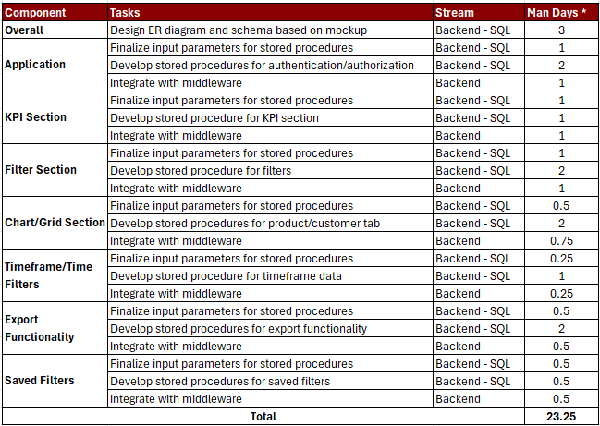
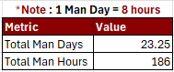
Sample Effort Estimation
Appendix
Design Mockup
*Tasks based on User Stories
** Refer to the user stories document for a detailed explanation.
Note:*The mentioned man-days are indicative and provided as a sample for effort estimation purposes

Slide 29
Essential Tools for Testing and Optimization
Appendix
S.No | Tool Name | When to Use | Why to Use | Key Features
1 | SQL Server Distributed Replay | To test database changes like version/ software upgrades and indexing | To simulate real-world workloads for performance impact analysis | Replays workloads, Scales for large datasets
2 | Apache JMeter | To evaluate database performance under high load | Simulates multiple users to analyze query and system behavior | Open-source, customizable, supports database stress testing
3 | LoadRunner | To analyze performance in enterprise-scale environments | It is an advanced tool for monitoring and analyzing performance bottlenecks. | Scalable testing, detailed metrics, database integration.
4 | Benchmark Factory | Benchmark and compare database performance across configurations. | Automates testing and provides performance comparisons for optimization. | Predefined benchmarks, easy interface, supp

Slide 30
Essential Tools for Maintenance
Appendix
S.No | Tool Name | When to Use | Why to Use | Key Features
1 | SolarWinds | For network, systems, and application monitoring | Comprehensive monitoring, real-time alerts, and reporting | Proactive issue detection, user-friendly dashboards, and diagnostics for IT infrastructure
2 | New Relic | For application performance monitoring (APM) | Tracks real-time metrics and enhances user experience | Detailed APM insights, performance optimization, and user interaction analysis
3 | Azure Defender | To secure Azure and hybrid cloud environments | Provides advanced threat detection and actionable insights. | Seamless Azure integration, threat protection, and vulnerability management
4 | Dynatrace | For full-stack monitoring of cloud environments | AI-driven insights and automation for quick resolution | End-to-end observability, microservices monitoring, and root cause analysis

Slide 31
Thank You !!

